Slide 1
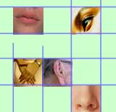
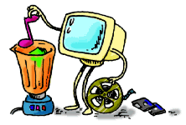

Introduction to Multimedia Chapter:10

Slide 2
What is Multimedia?
Derived from the word “Multi” and “Media”
  Multi
    Many, Multiple,
  Media
    Tools that is used to represent or do a certain things, delivery medium, a form of mass communication – newspaper, magazine / tv.
    Distribution tool & information presentation – text, graphic, voice, images, music and etc.

Slide 3

Definition of Multimedia
Multimedia is a combination of text, graphic, sound, animation, and video that is delivered interactively to the user by electronic or digitally manipulated means.
GRAPHIC
TEXT
MULTIMEDIA
VIDEO
AUDIO
ANIMATION

Slide 4
Elements of Multimedia
TEXT
GRAPHIC
TEXT
MULTIMEDIA
AUDIO
VIDEO
ANIMATION
A broad term for something that contains words to express something.
Text is the most basic element of multimedia.
A good choice of words could help convey the intended message to the users (keywords).
Used in contents, menus, navigational buttons

Slide 5
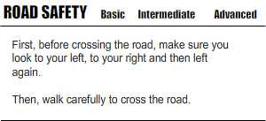
Elements of Multimedia
TEXT
GRAPHIC
TEXT
MULTIMEDIA
AUDIO
VIDEO
ANIMATION
Example

Slide 6
Elements of Multimedia
TEXT
GRAPHIC
GRAPHIC
MULTIMEDIA
AUDIO
VIDEO
ANIMATION
Two-dimensional figure or illustration
Could be produced manually (by drawing, painting, carving, etc.) or by computer graphics technology.
Used in multimedia to show more clearly what a particular information is all about (diagrams, picture).

Slide 7
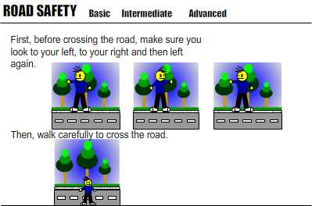
Elements of Multimedia
TEXT
GRAPHIC
GRAPHIC
MULTIMEDIA
AUDIO
VIDEO
ANIMATION
Example

Slide 8
Elements of Multimedia
TEXT
GRAPHIC
AUDIO
MULTIMEDIA
AUDIO
VIDEO
ANIMATION
Produced by vibration, as perceived by the sense of hearing.
In multimedia, audio could come in the form of speech, sound effects and also music score.

Slide 9
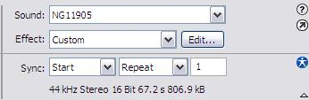
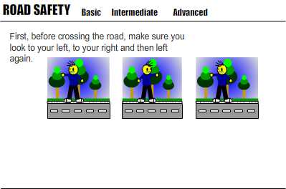
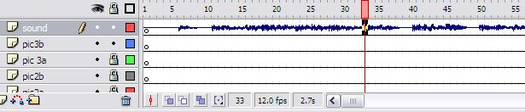
Elements of Multimedia
TEXT
GRAPHIC
AUDIO
MULTIMEDIA
AUDIO
VIDEO
ANIMATION
Example

Slide 10
Elements of Multimedia
TEXT
GRAPHIC
ANIMATION
MULTIMEDIA
AUDIO
VIDEO
ANIMATION
The illusion of motion created by the consecutive display of images of static elements.
In multimedia, animation is used to further enhance / enriched the experience of the user to further understand the information conveyed to them.

Slide 11
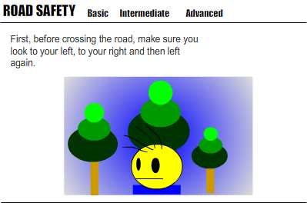
Elements of Multimedia
TEXT
GRAPHIC
ANIMATION
MULTIMEDIA
AUDIO
VIDEO
ANIMATION
Example

Slide 12
Elements of Multimedia
TEXT
GRAPHIC
VIDEO
MULTIMEDIA
AUDIO
VIDEO
ANIMATION
Is the technology of capturing, recording, processing, transmitting, and reconstructing moving pictures.
Video is more towards photo realistic image sequence / live recording as in comparison to animation.
Video also takes a lot of storage space. So plan carefully before you are going to use it.

Slide 13
Interactive Multimedia
When the user is given the option of controlling the elements.
Hyper Media
A combination of hypertext, graphics, audio, video, (linked elements) and interactivity culminating in a complete, non-linear computer-based experience.

Slide 14
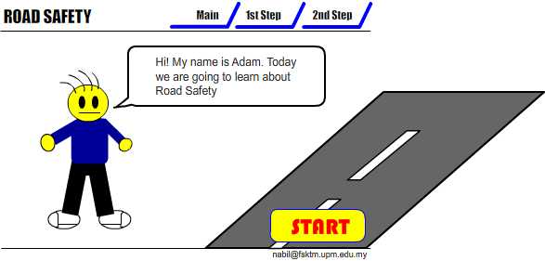
Example
Interactive Multimedia

Slide 15
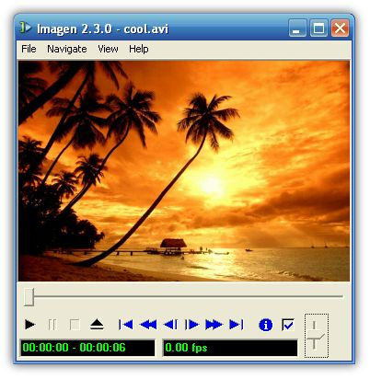


Example
Hyper Media
Main Page
Video link
Image link
Audio Link

Slide 16
Authoring Tools
Use to merge multimedia elements (text, audio, graphic, animation, video) into a project.
Designed to manage individual multimedia elements and provide user interaction (if required).

Slide 17
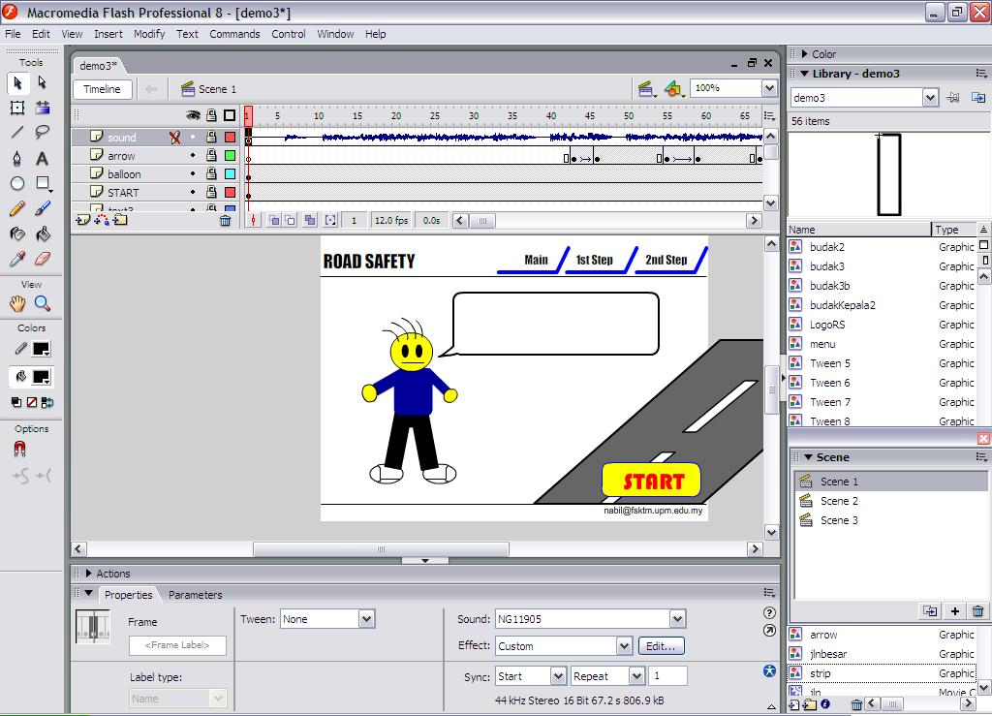
Authoring Tools
Example:
  Macromedia Authorware
  Macromedia Director
  Macromedia Flash
  Microsoft Power Point

Slide 18
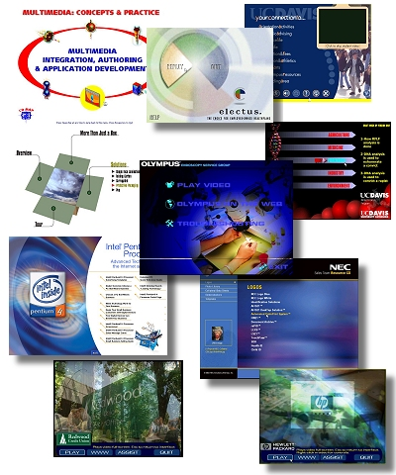
Importance of Multimedia
There are a number of fields where multimedia could be of use. Examples are:-
  Business
  Education
  Entertainment
  Home
  Public Places

Slide 19
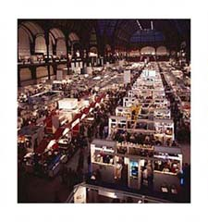
Importance of Multimedia
Business
  Use and Applications
    Sales / Marketing Presentation
    Trade show production
    Staff Training Application
    Company Kiosk

Slide 20

Importance of Multimedia
Education
  Use and Applications
    Courseware / Simulations
    E-Learning / Distance Learning
    Information Searching

Slide 21

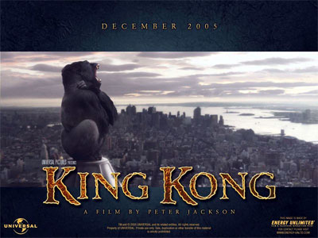
Importance of Multimedia
Entertainment
  Use and Applications
    Games (Leisure / Educational)
    Movies
    Video on Demand
      Online

Slide 22



Importance of Multimedia
Home
  Use and Applications
    Television
    Satellite TV
    SMS services (chats, voting, reality TV)

Slide 23

Importance of Multimedia
Public Places
  Use and Applications
    Information Kiosk
    Smart Cards, Security

Slide 24
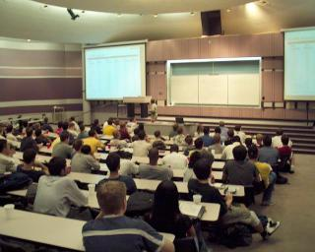
Multimedia Products
Briefing Products
1
Good briefing presentation depends on:
  The understanding of the presented subject.
  Seamless integration of content.
  Consistent layout
Example:
  Corporate Presentation
  Sales Presentation
  Educational Lectures
2/2

Slide 25
Multimedia Products
Reference Products
2
Often used for answering specific questions or for general browsing of information. (stored on CD/ DVD ROM)
Characteristic of reference product:
  Used by wide range of user (small – adult)
  Have navigational menu, book marking, searching, printing utility
2 Basic classes of reference product:
  Generalized Content (dictionary/encyclopedia)
    Broad treatment of content at a limited depth
  Detailed Content
    Focus on specific area and provide extensive information.
1/2

Slide 26
Multimedia Products
Reference Products
2
Good usability and success depends on:
  The developers understanding the body of information and how the end user will want to access it.
  Help function should always available to explain how to access and use the information
Examples are electronic forms of:
  Encyclopedia
  Dictionaries
  Cookbooks, Historical, Informative
  Scientific surveys.
2/2

Slide 27
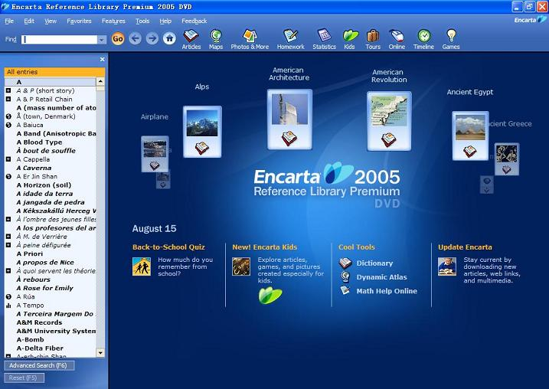
Multimedia Products
Reference Products
2
Example:
2/2

Slide 28
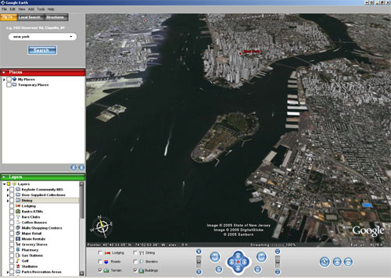
Multimedia Products
Database Products
3
Examples are:
  Google Search
  Google Earth
2/2

Slide 29
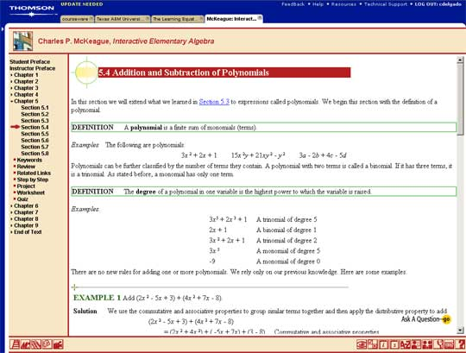
Multimedia Products
Education and Training Products
4
Similar to textbook or training manuals but have added media such as audio, animation and video.
Make up a significant share of the multimedia market ranging from pre-kindergarten to postgraduate offerings from technical to corporate training products.
2 categories of reference product:
  Instructor Support Products
  Standalone or Self-Paced Products
  Combination Products
Shares the same characteristics as Reference Product
1/2

Slide 30
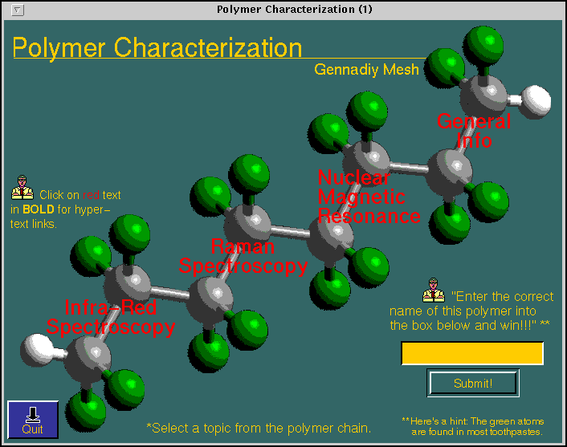
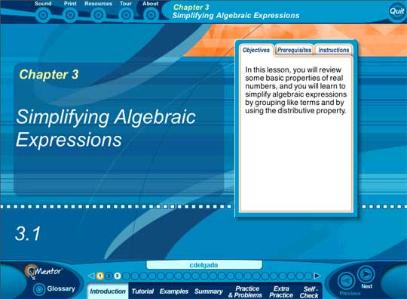
Multimedia Products
Education and Training Products
4
Example
2/2

Slide 31
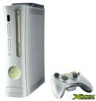

Multimedia Products
Entertainment & Games
6
Most popular
Shipped in the form of Interactive CD / DVD ROM.
Characteristics of E & G Products:-
  Immersive.
  Requires constant feedback and interaction with the user.
  Challenging and sometimes intriguing for user
  Enabled online play for more than one user experience.

